Slide 1


Chapter 9 . Ex#9.1
Infinite Sequences & Series

Slide 2


Sequence :
A sequence can be thought of as a list of numbers written in a definite order:
$$a_{1},a_{2},a_{3},………….,a_{n}$$
Where n is called the index of the sequence
The number $a_{1}$ is called the first term, $a_{2}$is the second term, and in general $a_{n}$is the nth term .

Slide 3


Slide 4

Examples :

Slide 5


Slide 6


Slide 7


Slide 8
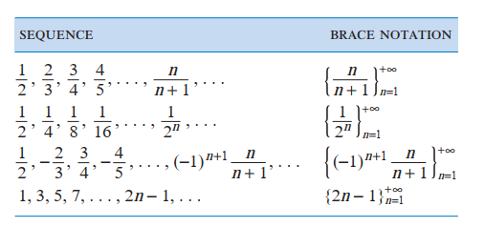

Slide 9





Slide 10


Slide 11
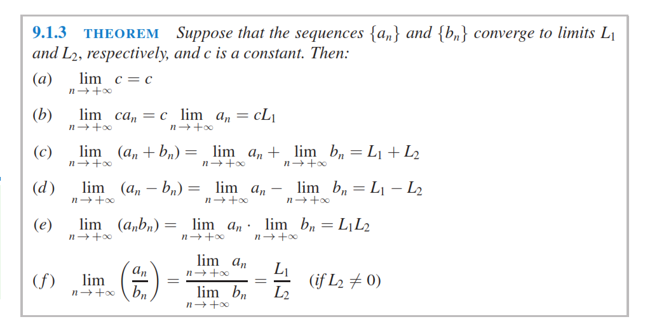

Slide 12


Slide 13




Slide 14
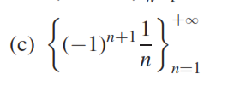



Slide 15



Slide 16

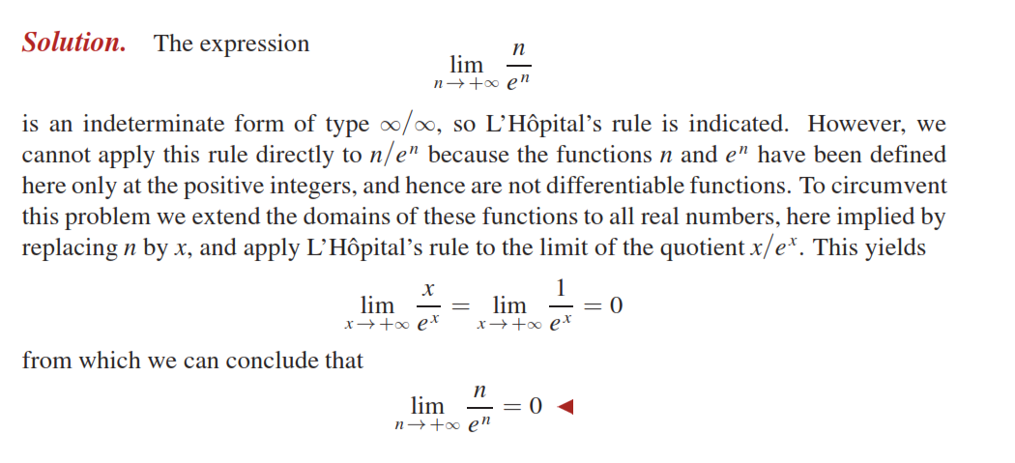

Slide 17



Slide 18




Slide 19



Slide 20



Slide 21

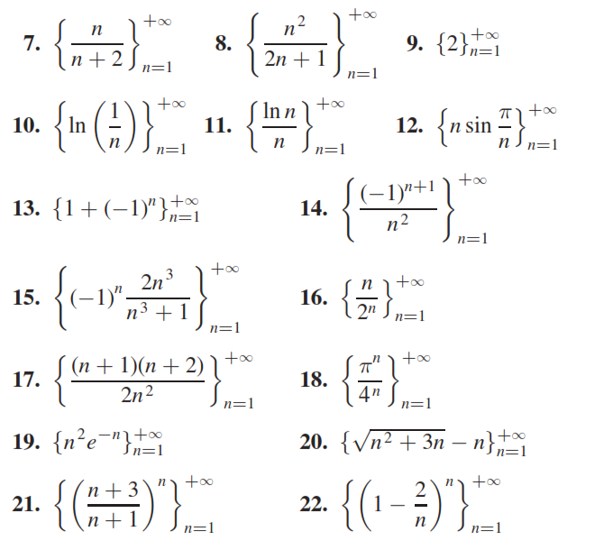

Slide 22
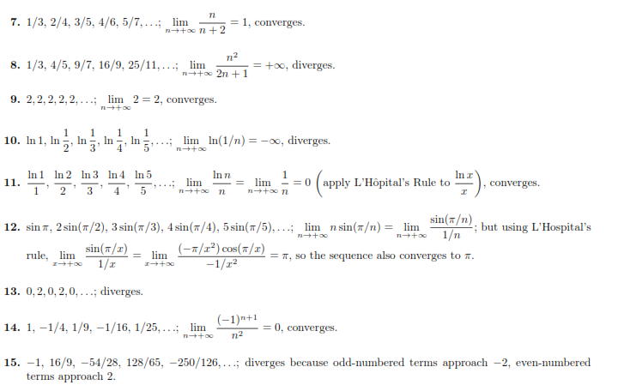

Slide 23
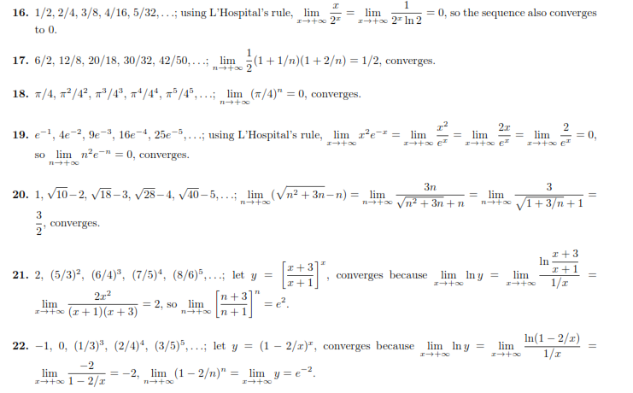

Slide 24
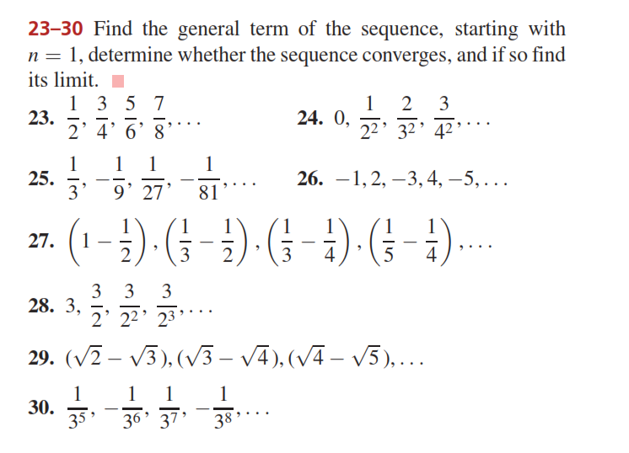

Slide 25
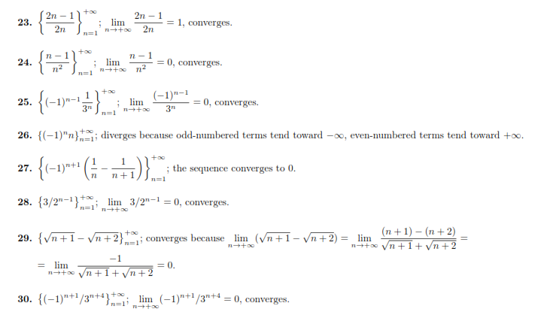

Slide 26
Do Questions (1, 7-30) from Ex # 9.1

